Slide 1


Hotel Management System

Slide 2
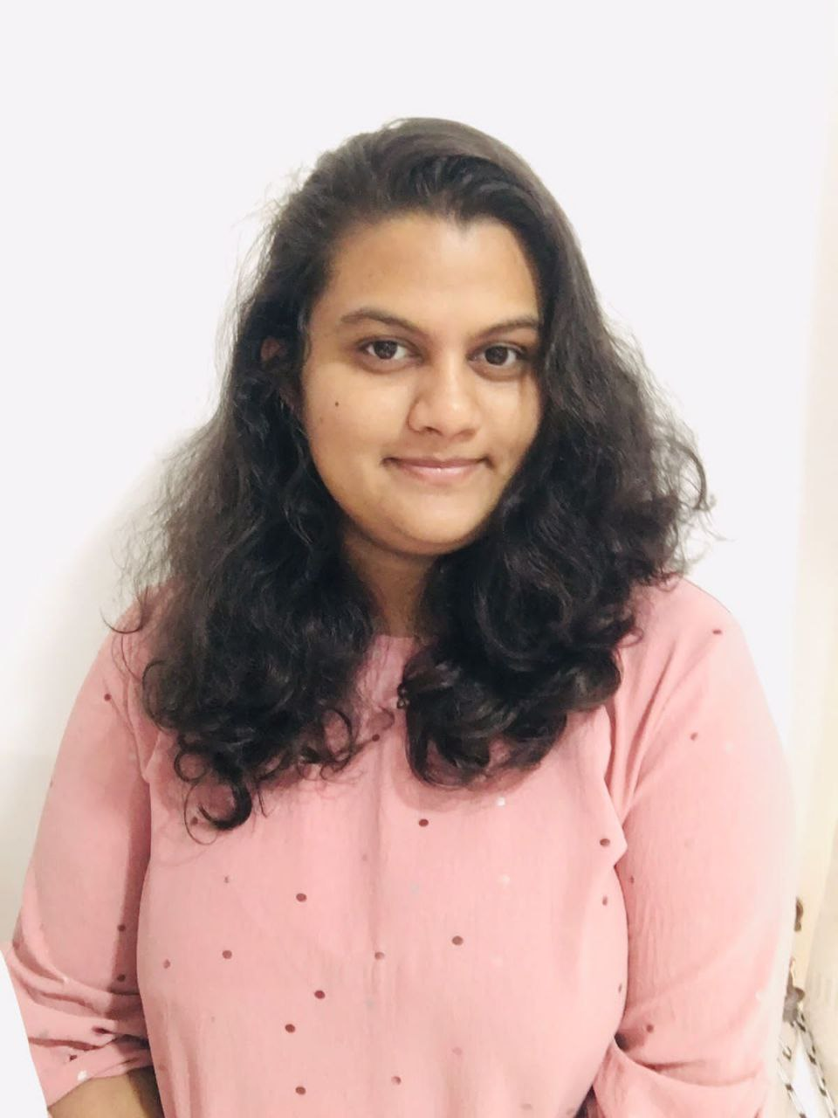

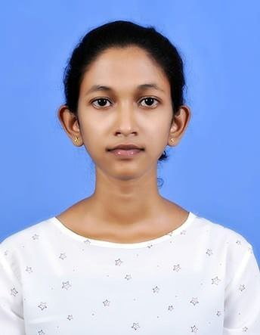
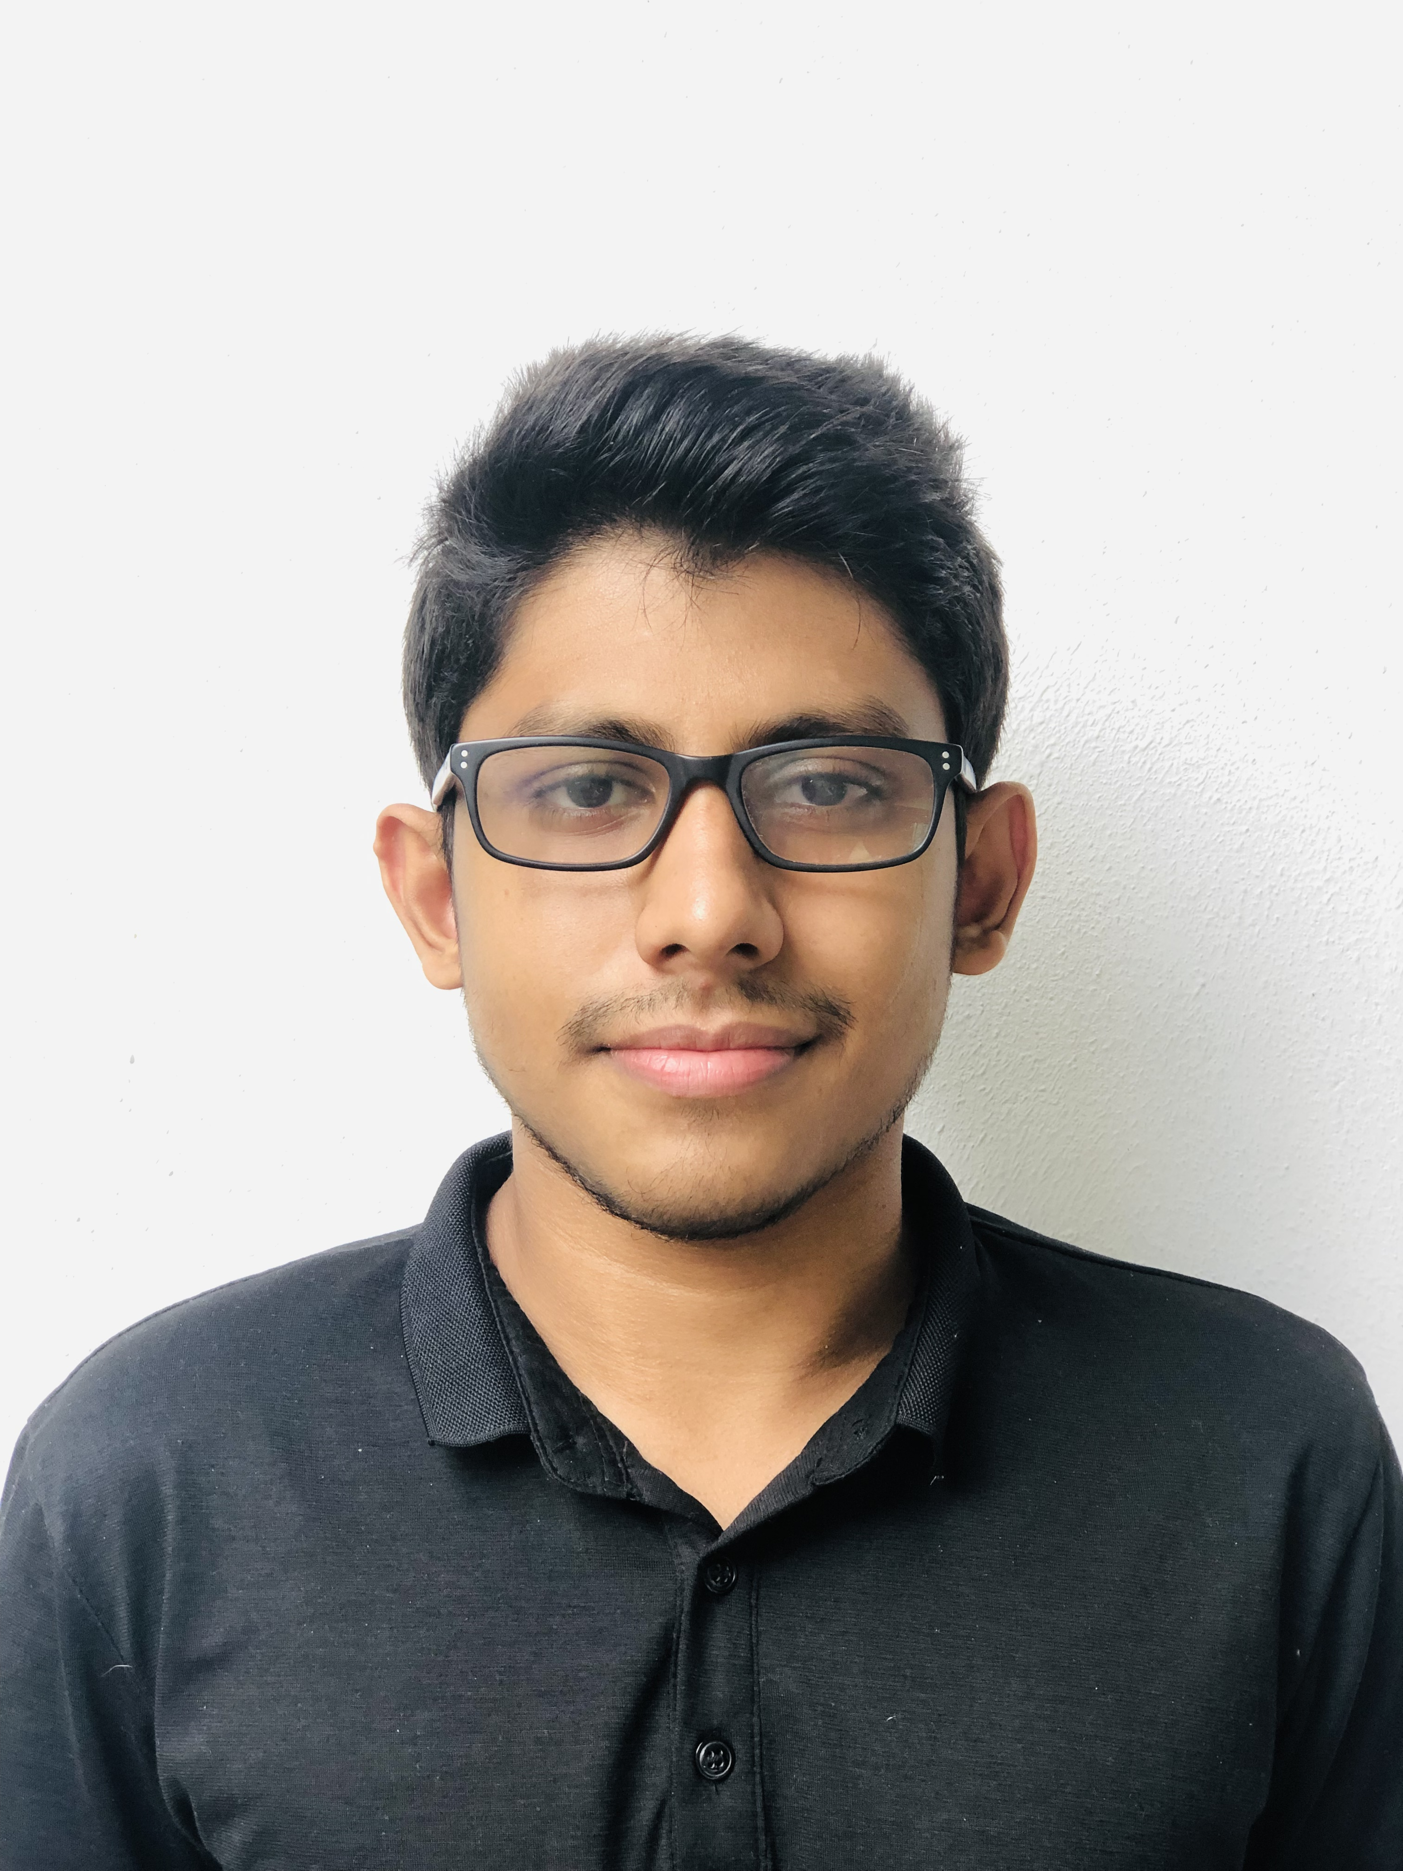
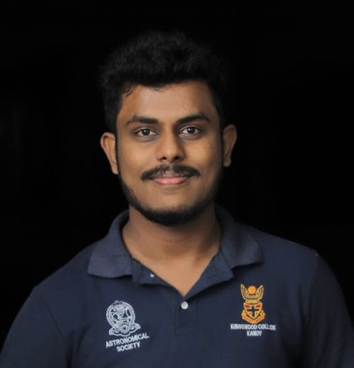
OUR TEAM
Tehan Pemasiri
Gayathri Dunuthuthilaka
Shahnas Aysha
Sanderkha Gunasiri
Geethaka Pitigala
Leader

Slide 3

Introduction
Circlebook is a Software development company mainly based on Sri Lanka.
CircleBook company is specialized in developing information systems that works as SaaS mainly hosted on a platform called Awakaza built on AWS cloud.
Yearly or Monthly Payments
Some of other Awakaza Cloud systems would include,
Awakaza Cheque Management System
Awakaza Reservation Management System
Awakaza POS
Awakaza HRM

Slide 4
Problem in Brief
Medium to large Hotels can't survive without Good information systems backing them.
Very expensive alternatives
Having to pay for 90% of the features that has no use
Not compatible in Sri Lankan/Asian Hotels
Requirement for a low cost tailored Hotel Management System from clients

Slide 5
Solution
Hotel Management System

Slide 6
Aim & Objectives
Aim
A Hotel Management System
Low Cost
Tailored to client needs
No overly complex bloat features

Slide 7
Aim & Objectives
Objectives
System should be able to store and manage information on all domains
Front office
house keeping
food and beverages
kitchen
Engineering
Purchasing
accounts
marketing

Slide 8
Objectives – (continued)
Phase one:
Front Office Front Ops
Front Office Back Ops
Housekeeping and Mini Bar ops
Billing
Administration Portal

Slide 9
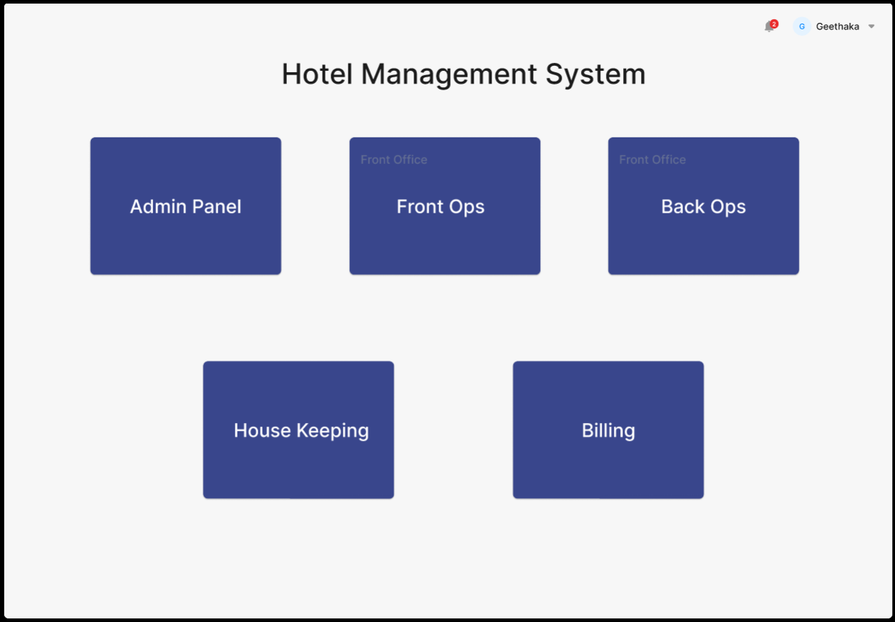
Hotel Management System

Slide 10
UI Designs

Slide 11
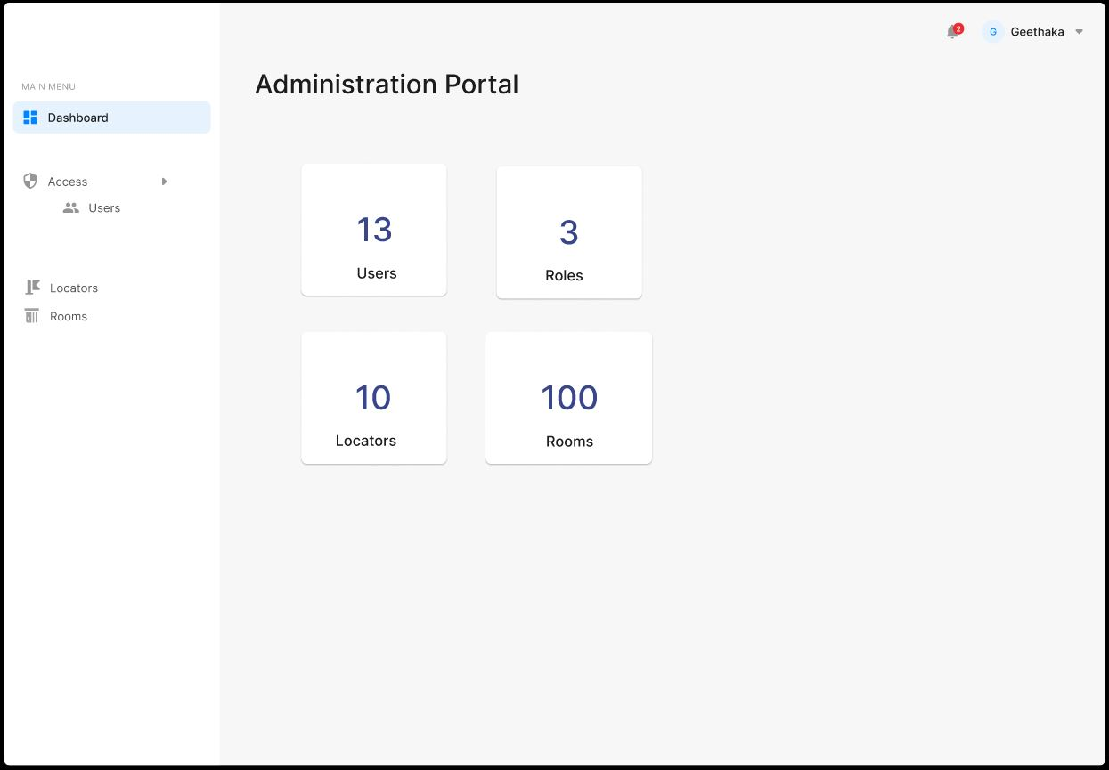
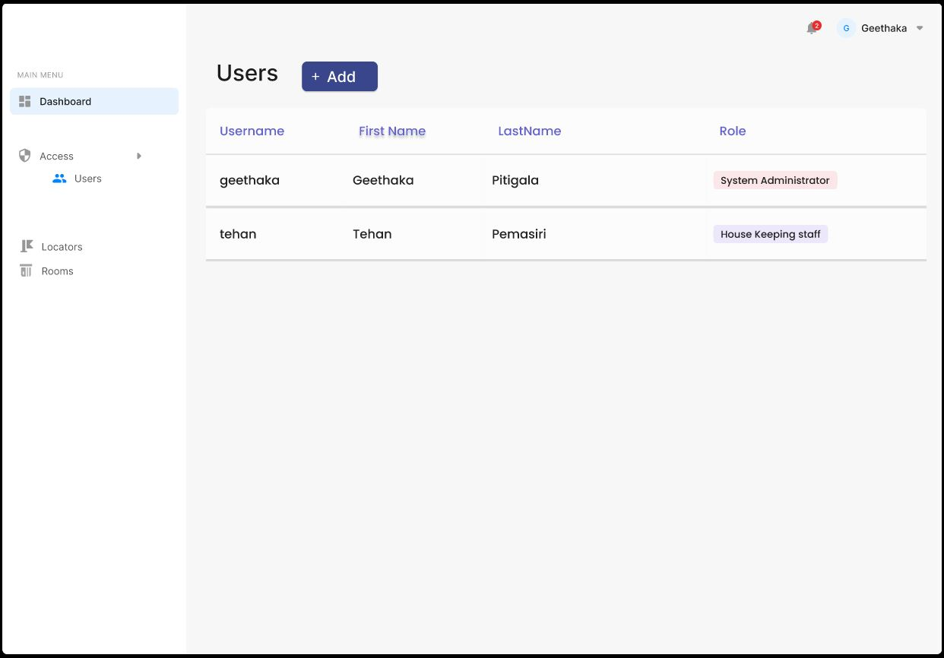
Admin Dashboard
UI Designs: Admin Panel - Figma

Slide 12
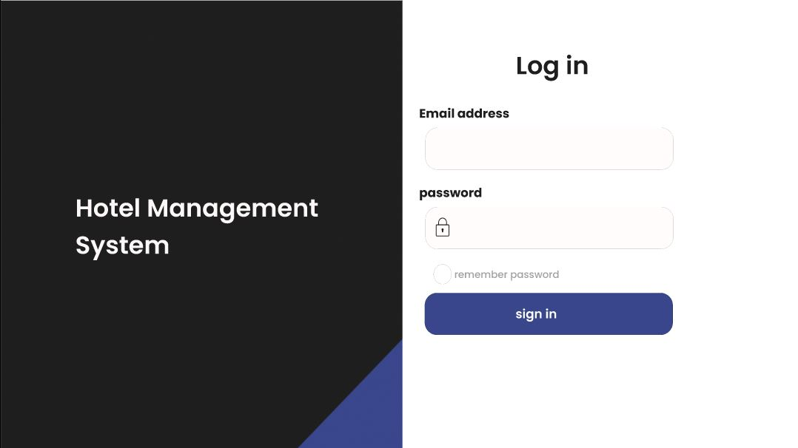

Slide 13
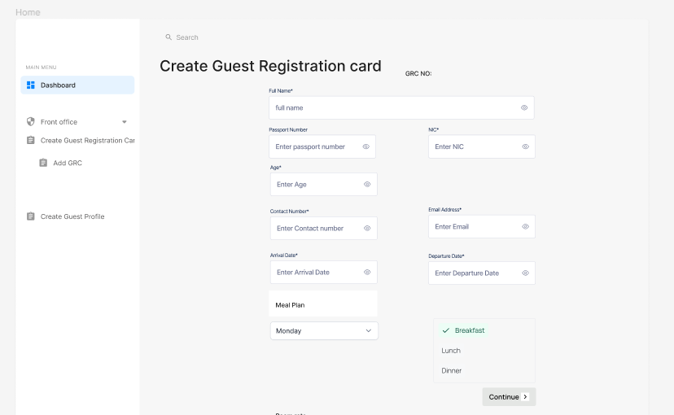
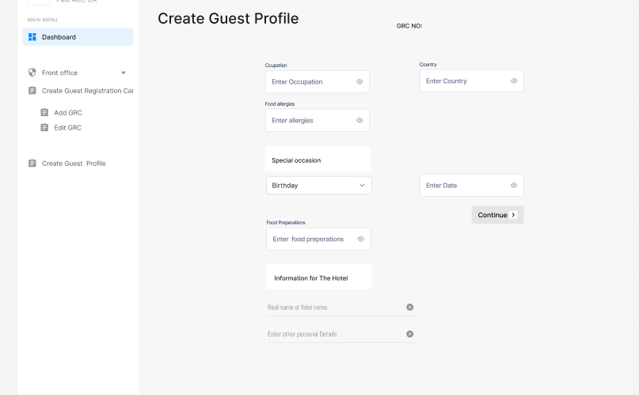
Guest Registration Dashboard and Guest profile Dashboard
UI Designs: Front Operations - Figma

Slide 14
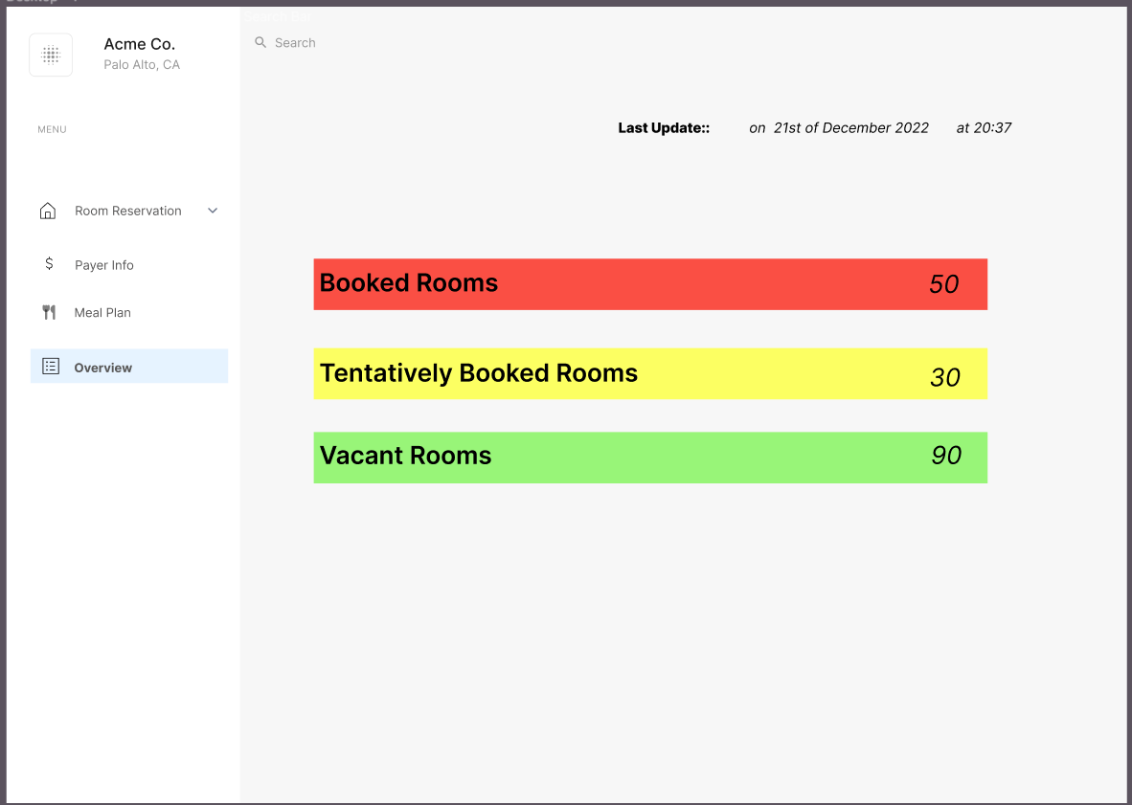
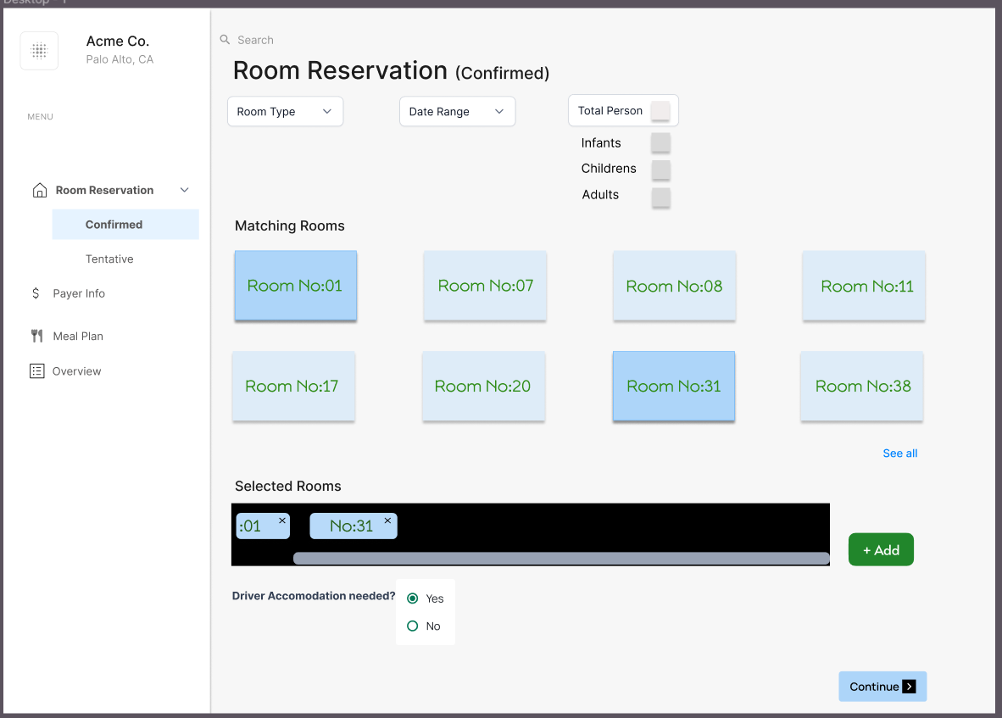
Reservation Management
UI Designs: FrontOffice_BackOps – Figma

Slide 15
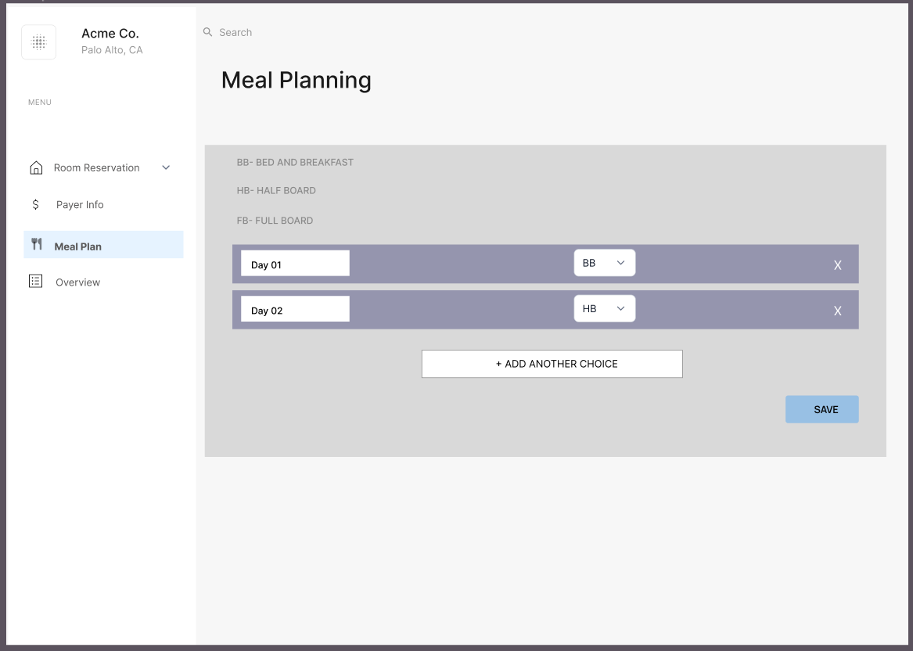
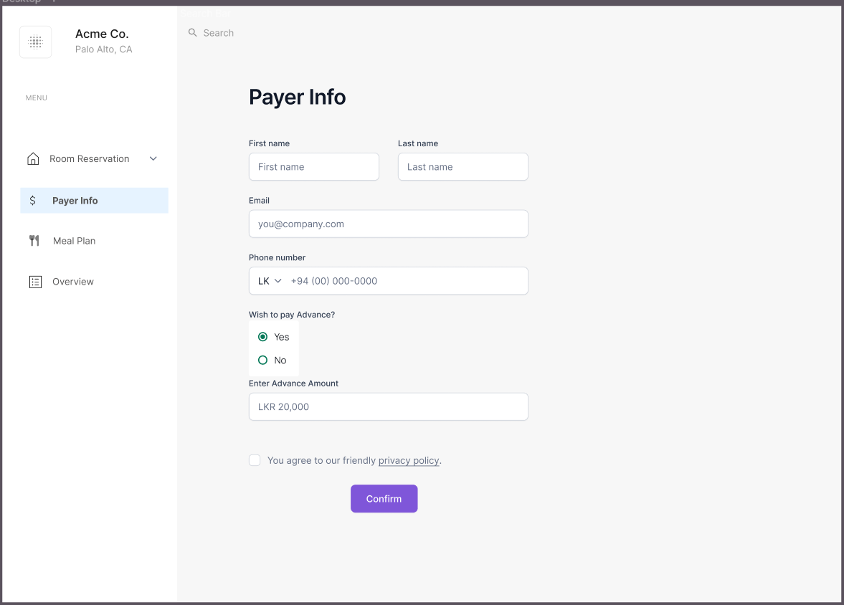

Slide 16
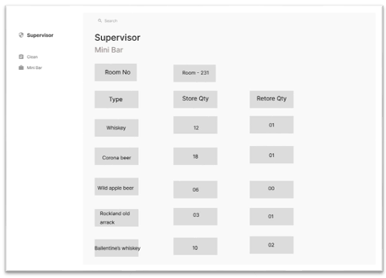
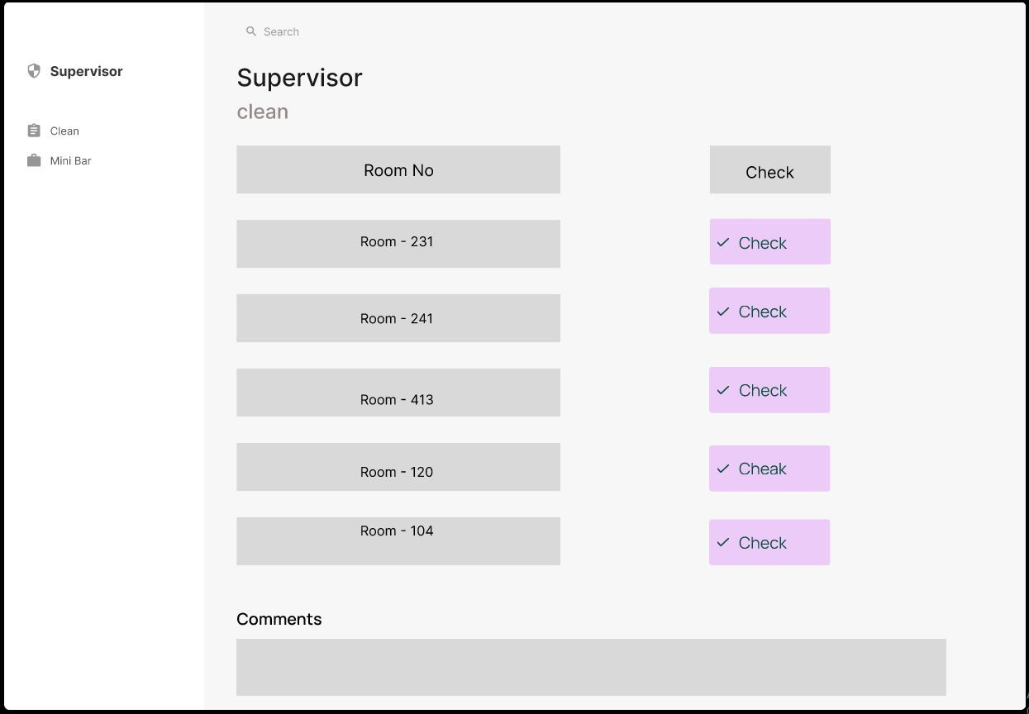
Housekeeping Operations
UI Designs: Housekeeping - Figma

Slide 17
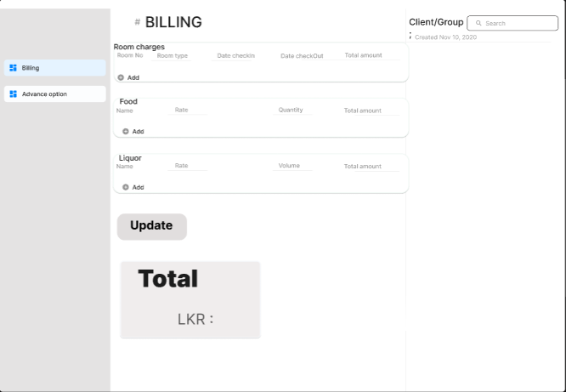
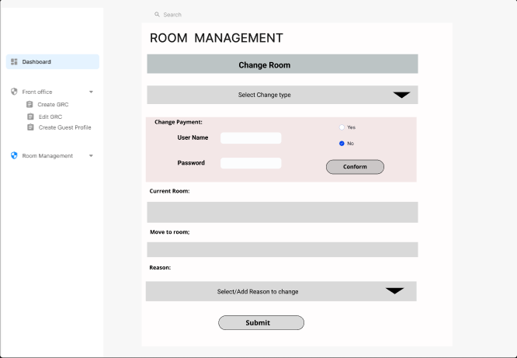
Billing & Room Change
UI Designs: Billing & Room Change - Figma

Slide 18
Individual Contributions

Slide 19
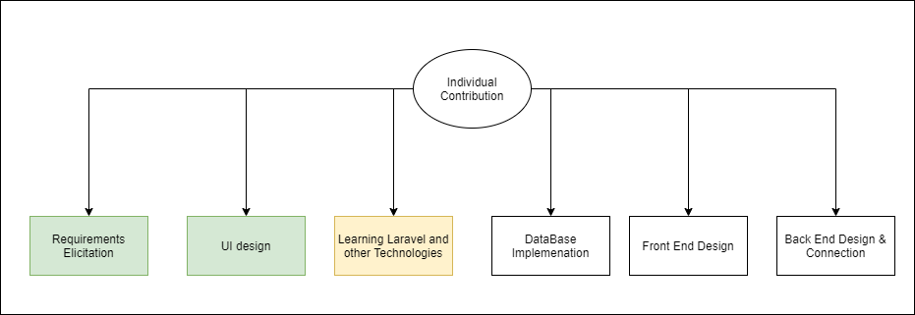

Slide 20



Geethaka -> Administration Portal
Sandarekha -> Billing & Room Operations
Aysha -> Front office Back operations
Tehan -> Front office Front operations
Gayathri -> Housekeeping & Minibar operations
Assigned Components

Slide 21
Thank You

